Slide 1

LEO Trajectory Predictor
Ishan Vasishta Bhatt
F. Y. B. Tech.(2015-16), Dept. Of Computer Engg., BVM.
ID no.: 15CP015
Enrolment no.: 150070107006
Course: Computer Programming
“Given enough time, Hydrogen starts to wonder where it came from and where it is going”

Slide 2
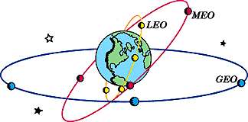
Low Earth Orbits
It extends from about 600km to 1600 km high in earth’s atmosphere.
It is comparatively cheaper to launch projectiles in these orbits.
The satellites in these orbits have comparatively smaller coverage area.

Slide 3
Assumptions
The surface of the earth is assumed to be a horizontal plane.
Resistance due to atmosphere is neglected.
This is critical because, at high velocities frictional forces are way stronger than gravitational forces.
It is assumed that upon reaching the target height the module will have enough fuel for performing minor manoeuvres to place it into orbit.

Slide 4
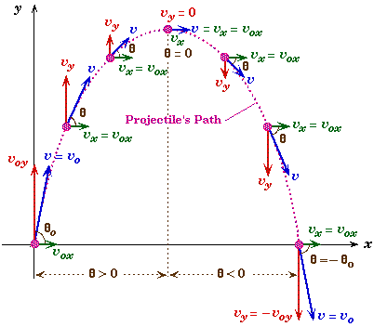
How to construct the trajectory?
The trajectory is calculated by following Newtonian mechanics for projectile motion:

Slide 5
One Note
Instead of plotting the trajectory, like one would draw on the paper or like the projectile would actually trace in space, this program constructs the trajectory from top to bottom, much like a printer prints on pages.

Slide 6
Some more assumptions
It is assumed that the motion of the projectile is entirely two-dimensional.
The program also neglects all other forces acting on the projectile other than the thrust of its engine and gravity.

Slide 7
Thrust of the rocket
Usually, a space-probe acquires most of its momentum within seconds after the launch and looses a considerable amount of mass(fuel).
The program assumes this time to be zero.
The mass lost is also neglected.
It is also assumed that the user knows the velocity and angle of projection after this initial exercise.

Slide 8
Gravity
Gravitational force extends to infinity. This means that the farthest stars from us exert some (however little) force to the space-crafts. This is neglected.
No Gravitational force other than that exerted by the earth assuming it to be a perfect sphere is considered.

Slide 9
Variations in gravity
Variation in g with height and position on earth are considered.

Slide 10
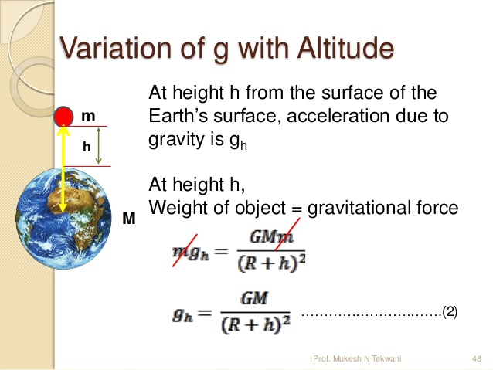

Slide 11
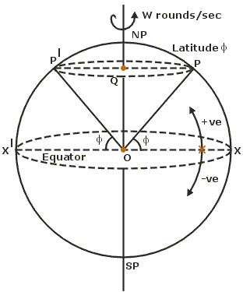
Variation of g with Latitude
This variation is due to the centrifugal force generated by the rotation of the earth.
It is given by:
g’ = g-w²Rcos²Ф

Slide 12
A problem with console & Scope for the future
It was found, during the development of this program that the maximum size of a console is only 9999x9999 in windows 10.
This limits the scale to 1km² :1 character space.
However, using the same logic, this program can become more fruitful in an environment where display sizes are not limited.

Slide 13
Thank you!

